Slide 1
Elasticity and Its Application
© 2015 Cengage Learning. All Rights Reserved. May not be copied, scanned, or duplicated, in whole or in part, except for use as permitted in a license distributed with a certain product or service or otherwise on a password-protected website for classroom use.

Slide 2
The Elasticity of Demand
Elasticity
  Measure of the responsiveness of quantity demanded or quantity supplied
  To a change in one of its determinants
Price elasticity of demand
  How much the quantity demanded of a good responds to a change in the price of that good
© 2015 Cengage Learning. All Rights Reserved. May not be copied, scanned, or duplicated, in whole or in part, except for use as permitted in a license distributed with a certain product or service or otherwise on a password-protected website for classroom use.

Slide 3
The Elasticity of Demand
Price elasticity of demand
  Percentage change in quantity demanded divided by the percentage change in price
Elastic demand
  Quantity demanded responds substantially to changes in price
Inelastic demand
  Quantity demanded responds only slightly to changes in price
© 2015 Cengage Learning. All Rights Reserved. May not be copied, scanned, or duplicated, in whole or in part, except for use as permitted in a license distributed with a certain product or service or otherwise on a password-protected website for classroom use.

Slide 4
The Elasticity of Demand
Determinants of price elasticity of demand
  Availability of close substitutes
    Goods with close substitutes: more elastic demand
  Necessities vs. luxuries
    Necessities: inelastic demand
    Luxuries: elastic demand
© 2015 Cengage Learning. All Rights Reserved. May not be copied, scanned, or duplicated, in whole or in part, except for use as permitted in a license distributed with a certain product or service or otherwise on a password-protected website for classroom use.

Slide 5
The Elasticity of Demand
Determinants of price elasticity of demand
  Definition of the market
    Narrowly defined markets: more elastic demand
  Time horizon
    Demand is more elastic over longer time horizons
© 2015 Cengage Learning. All Rights Reserved. May not be copied, scanned, or duplicated, in whole or in part, except for use as permitted in a license distributed with a certain product or service or otherwise on a password-protected website for classroom use.

Slide 6
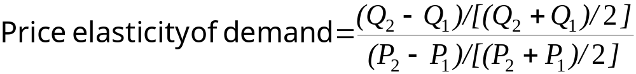
The Elasticity of Demand
Computing the price elasticity of demand
  Percentage change in quantity demanded divided by percentage change in price
  Use absolute value (drop the minus sign)
Midpoint method
  Two points: (Q₁, P₁) and (Q₂, P₂)
© 2015 Cengage Learning. All Rights Reserved. May not be copied, scanned, or duplicated, in whole or in part, except for use as permitted in a license distributed with a certain product or service or otherwise on a password-protected website for classroom use.

Slide 7
The Elasticity of Demand
Variety of demand curves
  Demand is elastic
    Price elasticity of demand > 1
  Demand is inelastic
    Price elasticity of demand < 1
  Demand has unit elasticity
    Price elasticity of demand = 1
© 2015 Cengage Learning. All Rights Reserved. May not be copied, scanned, or duplicated, in whole or in part, except for use as permitted in a license distributed with a certain product or service or otherwise on a password-protected website for classroom use.

Slide 8
The Elasticity of Demand
Variety of demand curves
  Demand is perfectly inelastic
    Price elasticity of demand = 0
    Demand curve is vertical
  Demand is perfectly elastic
    Price elasticity of demand = infinity
    Demand curve is horizontal
The flatter the demand curve
  The greater the price elasticity of demand
© 2015 Cengage Learning. All Rights Reserved. May not be copied, scanned, or duplicated, in whole or in part, except for use as permitted in a license distributed with a certain product or service or otherwise on a password-protected website for classroom use.

Slide 9
Figure 1
The Price Elasticity of Demand (a, b)
Perfectly Inelastic Demand:
Elasticity Equals 0
(b) Inelastic Demand: Elasticity Is Less Than 1
Price
Price
1. An increase in price…
Demand
1. A 22%
increase
in price…
2. … leads to an 11% decrease in quantity demanded
$5
$5
4
4
2. …leaves
the quantity
demanded
unchanged
Demand
0
100
0
90
100
Quantity
Quantity
The price elasticity of demand determines whether the demand curve is steep or flat.
Note that all percentage changes are calculated using the midpoint method.
© 2015 Cengage Learning. All Rights Reserved. May not be copied, scanned, or duplicated, in whole or in part, except for use as permitted in a license distributed with a certain product or service or otherwise on a password-protected website for classroom use.

Slide 10
Figure 1
The Price Elasticity of Demand (c)
(c) Unit Elastic Demand: Elasticity Equals 1
Price
Demand
$5
1. A 22%
increase
in price…
4
2. … leads to a 22% decrease in quantity demanded
0
80
100
Quantity
The price elasticity of demand determines whether the demand curve is steep or flat.
Note that all percentage changes are calculated using the midpoint method.
© 2015 Cengage Learning. All Rights Reserved. May not be copied, scanned, or duplicated, in whole or in part, except for use as permitted in a license distributed with a certain product or service or otherwise on a password-protected website for classroom use.

Slide 11
Figure 1
The Price Elasticity of Demand (d, e)
(d) Elastic demand:
Elasticity > 1
(e) Perfectly elastic demand:
Elasticity equals infinity
Price
Price
1. At any price
above $4, quantity
demanded is zero
A 22%
increase
in price…
2. At exactly $4,
consumers will
buy any quantity
$5
4
Demand
$4
Demand
2. … leads to a 67% decrease in quantity demanded
3. At a price
below $4, quantity
demanded is infinite
0
50
100
0
Quantity
Quantity
The price elasticity of demand determines whether the demand curve is steep or flat.
Note that all percentage changes are calculated using the midpoint method.
© 2015 Cengage Learning. All Rights Reserved. May not be copied, scanned, or duplicated, in whole or in part, except for use as permitted in a license distributed with a certain product or service or otherwise on a password-protected website for classroom use.

Slide 12
The Elasticity of Demand
Total revenue, TR
  Amount paid by buyers and received by sellers of a good
  Price of the good times the quantity sold (P ˣ Q)
For a price increase
  If demand is inelastic, TR increases
  If demand is elastic, TR decreases
© 2015 Cengage Learning. All Rights Reserved. May not be copied, scanned, or duplicated, in whole or in part, except for use as permitted in a license distributed with a certain product or service or otherwise on a password-protected website for classroom use.

Slide 13
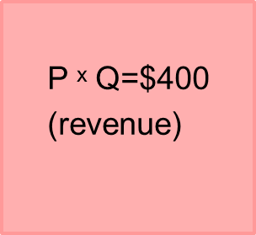
Figure 2
Total Revenue
Price
$4
P
Demand
0
100
Quantity
Q
The total amount paid by buyers, and received as revenue by sellers, equals the area of the box under the demand curve, P × Q. Here, at a price of $4, the quantity demanded is 100, and total revenue is $400.
© 2015 Cengage Learning. All Rights Reserved. May not be copied, scanned, or duplicated, in whole or in part, except for use as permitted in a license distributed with a certain product or service or otherwise on a password-protected website for classroom use.

Slide 14
Figure 3
How Total Revenue Changes When Price Changes (a)
(a) The Case of Inelastic Demand
Price
1. When the demand
curve is inelastic . . .
2. . . . the extra revenue from selling at a higher price . . .
$5
A
4
Demand
B
3. . . . is greater than the lost revenue from selling fewer units.
0
90
100
Quantity
The impact of a price change on total revenue (the product of price and quantity) depends on the elasticity of demand. In panel (a), the demand curve is inelastic. In this case, an increase in the price leads to a decrease in quantity demanded that is proportionately smaller, so total revenue increases. Here an increase in the price from $4 to $5 causes the quantity demanded to fall from 100 to 90. Total revenue rises from $400 to $450.
© 2015 Cengage Learning. All Rights Reserved. May not be copied, scanned, or duplicated, in whole or in part, except for use as permitted in a license distributed with a certain product or service or otherwise on a password-protected website for classroom use.

Slide 15
Figure 3
How Total Revenue Changes When Price Changes (b)
(b) The Case of Elastic Demand
Price
1. When the demand
curve is elastic . . .
2. . . . the extra revenue from selling at a higher price . . .
$5
A
4
3. . . . is less than the lost revenue from selling fewer units.
B
Demand
0
70
100
Quantity
The impact of a price change on total revenue (the product of price and quantity) depends on the elasticity of demand. In panel (b), the demand curve is elastic. In this case, an increase in the price leads to a decrease in quantity demanded that is proportionately larger, so total revenue decreases. Here an increase in the price from $4 to $5 causes the quantity demanded to fall from 100 to 70. Total revenue falls from $400 to $350.
© 2015 Cengage Learning. All Rights Reserved. May not be copied, scanned, or duplicated, in whole or in part, except for use as permitted in a license distributed with a certain product or service or otherwise on a password-protected website for classroom use.

Slide 16
The Elasticity of Demand
When demand is inelastic (elasticity < 1)
  P and TR move in the same direction
    If P ↑, TR also ↑
When demand is elastic (elasticity > 1)
  P and TR move in opposite directions
    If P ↑, TR ↓
If demand is unit elastic (elasticity = 1)
  Total revenue remains constant when the price changes
© 2015 Cengage Learning. All Rights Reserved. May not be copied, scanned, or duplicated, in whole or in part, except for use as permitted in a license distributed with a certain product or service or otherwise on a password-protected website for classroom use.

Slide 17
The Elasticity of Demand
Linear demand curve
  Constant slope
    Rise over run
  Different price elasticities
    Points with low price and high quantity
      Inelastic demand
    Points with high price and low quantity
      Elastic demand
© 2015 Cengage Learning. All Rights Reserved. May not be copied, scanned, or duplicated, in whole or in part, except for use as permitted in a license distributed with a certain product or service or otherwise on a password-protected website for classroom use.

Slide 18
Figure 4
Elasticity of a Linear Demand Curve (graph)
Price
1. an
$7
Elasticity is larger than 1
6
5
4
Elasticity is smaller than 1
3
2
Demand
1
0
2
4
6
8
10
12
14
Quantity
The slope of a linear demand curve is constant, but its elasticity is not. The demand schedule in the table was used to calculate the price elasticity of demand by the midpoint method. At points with a low price and high quantity, the demand curve is inelastic. At points with a high price and low quantity, the demand curve is elastic.
© 2015 Cengage Learning. All Rights Reserved. May not be copied, scanned, or duplicated, in whole or in part, except for use as permitted in a license distributed with a certain product or service or otherwise on a password-protected website for classroom use.

Slide 19
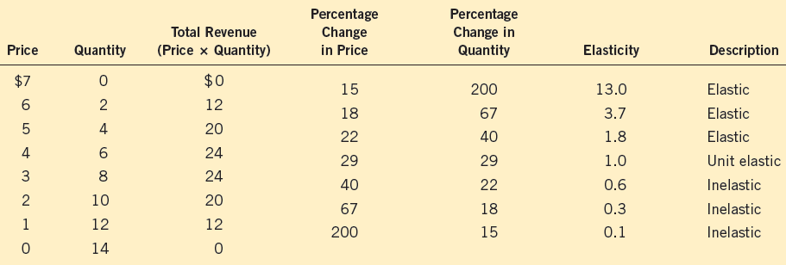
Figure 4
Elasticity of a Linear Demand Curve (schedule)
The slope of a linear demand curve is constant, but its elasticity is not. The demand schedule in the table was used to calculate the price elasticity of demand by the midpoint method. At points with a low price and high quantity, the demand curve is inelastic. At points with a high price and low quantity, the demand curve is elastic.
© 2015 Cengage Learning. All Rights Reserved. May not be copied, scanned, or duplicated, in whole or in part, except for use as permitted in a license distributed with a certain product or service or otherwise on a password-protected website for classroom use.

Slide 20
The Elasticity of Demand
Income elasticity of demand
  How much the quantity demanded of a good responds to a change in consumers’ income
  Percentage change in quantity demanded
    Divided by the percentage change in income
© 2015 Cengage Learning. All Rights Reserved. May not be copied, scanned, or duplicated, in whole or in part, except for use as permitted in a license distributed with a certain product or service or otherwise on a password-protected website for classroom use.

Slide 21
The Elasticity of Demand
Normal goods
  Positive income elasticity
  Necessities
    Smaller income elasticities
  Luxuries
    Large income elasticities
Inferior goods
  Negative income elasticities
© 2015 Cengage Learning. All Rights Reserved. May not be copied, scanned, or duplicated, in whole or in part, except for use as permitted in a license distributed with a certain product or service or otherwise on a password-protected website for classroom use.

Slide 22
The Elasticity of Demand
Cross-price elasticity of demand
  How much the quantity demanded of one good responds to a change in the price of another good
  Percentage change in quantity demanded of the first good
    Divided by the percentage change in price of the second good
© 2015 Cengage Learning. All Rights Reserved. May not be copied, scanned, or duplicated, in whole or in part, except for use as permitted in a license distributed with a certain product or service or otherwise on a password-protected website for classroom use.

Slide 23
The Elasticity of Demand
Substitutes
  Goods typically used in place of one another
  Positive cross-price elasticity
Complements
  Goods that are typically used together
  Negative cross-price elasticity
© 2015 Cengage Learning. All Rights Reserved. May not be copied, scanned, or duplicated, in whole or in part, except for use as permitted in a license distributed with a certain product or service or otherwise on a password-protected website for classroom use.

Slide 24
The Elasticity of Supply
Price elasticity of supply
  How much the quantity supplied of a good responds to a change in the price of that good
  Percentage change in quantity supplied
    Divided by the percentage change in price
  Depends on the flexibility of sellers to change the amount of the good they produce
© 2015 Cengage Learning. All Rights Reserved. May not be copied, scanned, or duplicated, in whole or in part, except for use as permitted in a license distributed with a certain product or service or otherwise on a password-protected website for classroom use.

Slide 25
The Elasticity of Supply
Elastic supply
  Quantity supplied responds substantially to changes in the price
Inelastic supply
  Quantity supplied responds only slightly to changes in the price
Determinant of price elasticity of supply
  Time period
    Supply is more elastic in long run
© 2015 Cengage Learning. All Rights Reserved. May not be copied, scanned, or duplicated, in whole or in part, except for use as permitted in a license distributed with a certain product or service or otherwise on a password-protected website for classroom use.

Slide 26
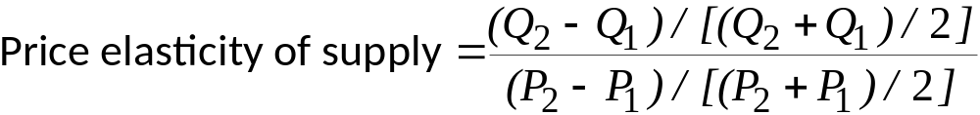
The Elasticity of Supply
Computing price elasticity of supply
  Percentage change in quantity supplied divided by percentage change in price
  Always positive
Midpoint method
  Two points: (Q₁, P₁) and (Q₂, P₂)
© 2015 Cengage Learning. All Rights Reserved. May not be copied, scanned, or duplicated, in whole or in part, except for use as permitted in a license distributed with a certain product or service or otherwise on a password-protected website for classroom use.

Slide 27
The Elasticity of Supply
Variety of supply curves
  Supply is unit elastic
    Price elasticity of supply = 1
  Supply is elastic
    Price elasticity of supply > 1
  Supply is inelastic
    Price elasticity of supply < 1
© 2015 Cengage Learning. All Rights Reserved. May not be copied, scanned, or duplicated, in whole or in part, except for use as permitted in a license distributed with a certain product or service or otherwise on a password-protected website for classroom use.

Slide 28
The Elasticity of Supply
Variety of supply curves
  Supply is perfectly inelastic
    Price elasticity of supply = 0
    Supply curve is vertical
  Supply is perfectly elastic
    Price elasticity of supply = infinity
    Supply curve is horizontal
© 2015 Cengage Learning. All Rights Reserved. May not be copied, scanned, or duplicated, in whole or in part, except for use as permitted in a license distributed with a certain product or service or otherwise on a password-protected website for classroom use.

Slide 29
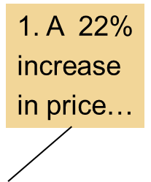
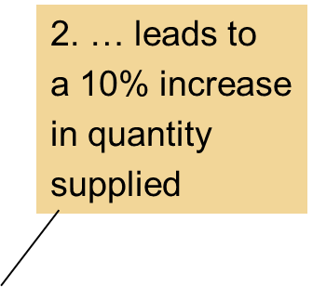
Figure 5
The Price Elasticity of Supply (a, b)
(a) Perfectly Inelastic Supply: Elasticity Equals 0
(b) Inelastic Supply: Elasticity Is Less Than 1
Price
Price
1. An
increase
in price…
Supply
Supply
$5
$5
4
2. …leaves
the quantity
supplied
unchanged
4
0
100
0
100
110
Quantity
Quantity
The price elasticity of supply determines whether the supply curve is steep or flat.
Note that all percentage changes are calculated using the midpoint method.
© 2015 Cengage Learning. All Rights Reserved. May not be copied, scanned, or duplicated, in whole or in part, except for use as permitted in a license distributed with a certain product or service or otherwise on a password-protected website for classroom use.

Slide 30
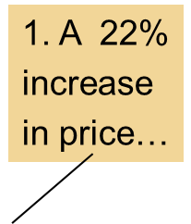
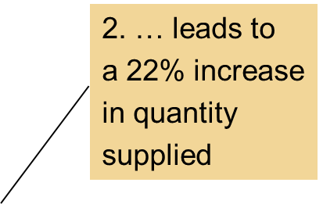
Figure 5
The Price Elasticity of Supply (c)
(c) Unit Elastic Supply: Elasticity Equals 1
Price
Supply
$5
4
0
100
125
Quantity
The price elasticity of supply determines whether the supply curve is steep or flat.
Note that all percentage changes are calculated using the midpoint method.
© 2015 Cengage Learning. All Rights Reserved. May not be copied, scanned, or duplicated, in whole or in part, except for use as permitted in a license distributed with a certain product or service or otherwise on a password-protected website for classroom use.

Slide 31
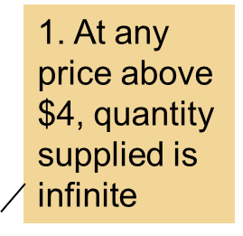
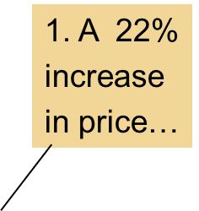
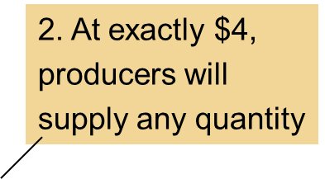
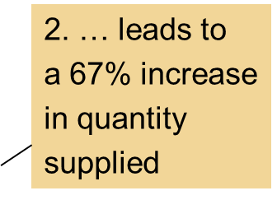
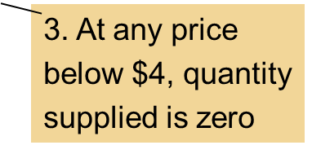
Figure 5
The Price Elasticity of Supply (d, e)
(d) Elastic Supply: Elasticity Is Greater Than 1
(e) Perfectly Elastic Supply: Elasticity Equals Infinity
Price
Price
Supply
$5
4
$4
Supply
0
100
50
0
Quantity
Quantity
The price elasticity of supply determines whether the supply curve is steep or flat.
Note that all percentage changes are calculated using the midpoint method.
© 2015 Cengage Learning. All Rights Reserved. May not be copied, scanned, or duplicated, in whole or in part, except for use as permitted in a license distributed with a certain product or service or otherwise on a password-protected website for classroom use.

Slide 32
The Elasticity of Supply
Supply curve
  Different price elasticities
    Points with low price and low quantity
      Elastic supply
      Capacity for production not being used
    Points with high price and high quantity
      Inelastic supply
© 2015 Cengage Learning. All Rights Reserved. May not be copied, scanned, or duplicated, in whole or in part, except for use as permitted in a license distributed with a certain product or service or otherwise on a password-protected website for classroom use.

Slide 33
Figure 6
How the Price Elasticity of Supply Can Vary
Price
Elasticity is small
(less than 1).
Supply
$15
12
Elasticity is large
(greater than 1).
4
3
0
100
200
500
525
Quantity
Because firms often have a maximum capacity for production, the elasticity of supply may be very high at low levels of quantity supplied and very low at high levels of quantity supplied. Here an increase in price from $3 to $4 increases the quantity supplied from 100 to 200. Because the 67% increase in quantity supplied (computed using the midpoint method) is larger than the 29% increase in price, the supply curve is elastic in this range. By contrast, when the price rises from $12 to $15, the quantity supplied rises only from 500 to 525. Because the 5% increase in quantity supplied is smaller than the 22% increase in price, the supply curve is inelastic in this range.
© 2015 Cengage Learning. All Rights Reserved. May not be copied, scanned, or duplicated, in whole or in part, except for use as permitted in a license distributed with a certain product or service or otherwise on a password-protected website for classroom use.

Slide 34
Applications
Can Good News for Farming Be Bad News for Farmers?
  New hybrid of wheat – increase production per acre 20%
    Supply curve shifts to the right
    Higher quantity and lower price
    Demand is inelastic: total revenue falls
© 2015 Cengage Learning. All Rights Reserved. May not be copied, scanned, or duplicated, in whole or in part, except for use as permitted in a license distributed with a certain product or service or otherwise on a password-protected website for classroom use.

Slide 35
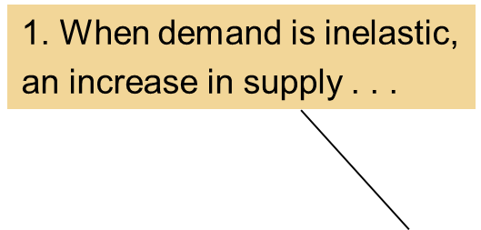
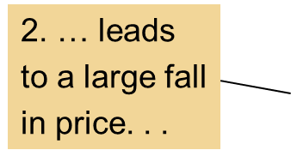
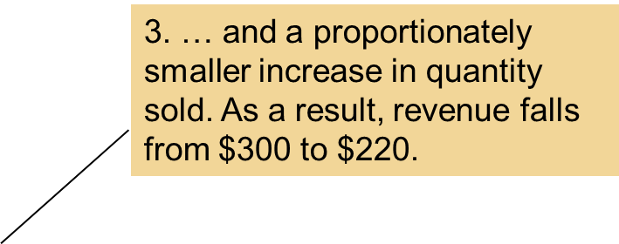
Figure 7
An Increase in Supply in the Market for Wheat
Price of
Wheat
S₁
S₂
$3
2
Demand
0
100
110
Quantity of Wheat
When an advance in farm technology increases the supply of wheat from S₁ to S₂, the price of wheat falls. Because the demand for wheat is inelastic, the increase in the quantity sold from 100 to 110 is proportionately smaller than the decrease in the price from $3 to $2. As a result, farmers’ total revenue falls from $300 ($3 × 100) to $220 ($2 × 110).
© 2015 Cengage Learning. All Rights Reserved. May not be copied, scanned, or duplicated, in whole or in part, except for use as permitted in a license distributed with a certain product or service or otherwise on a password-protected website for classroom use.

Slide 36


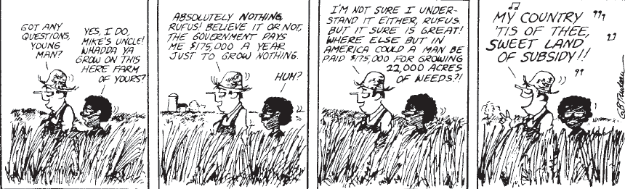
Applications
Can Good News for Farming Be Bad News for Farmers?
  Paradox of public policy
    Induce farmers not to plant crops
© 2015 Cengage Learning. All Rights Reserved. May not be copied, scanned, or duplicated, in whole or in part, except for use as permitted in a license distributed with a certain product or service or otherwise on a password-protected website for classroom use.

Slide 37
Applications
Why Did OPEC Fail to Keep the Price of Oil High?
  Increase in prices 1973-1974, 1971-1981
  Short-run: supply and demand are inelastic
    Decrease in supply: large increase in price
  Long-run: supply and demand are elastic
    Decrease in supply: small increase in price
© 2015 Cengage Learning. All Rights Reserved. May not be copied, scanned, or duplicated, in whole or in part, except for use as permitted in a license distributed with a certain product or service or otherwise on a password-protected website for classroom use.

Slide 38
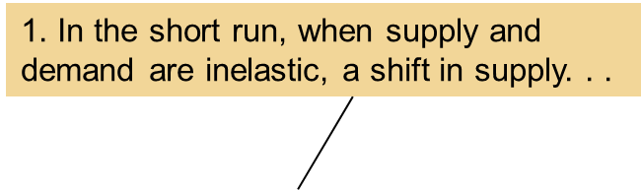
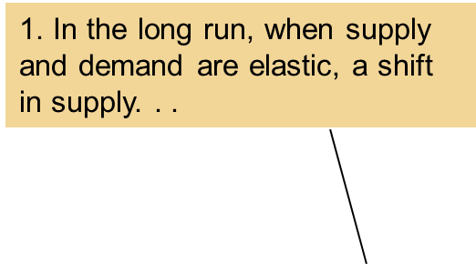
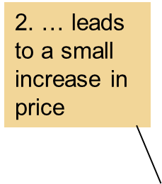
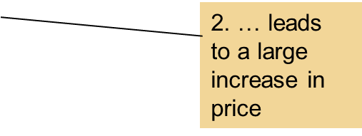
Figure 8
A Reduction in Supply in the World Market for Oil
(a) The Oil Market in the Short Run
(b) The Oil Market in the Long Run
Price
Price
S₂
S₁
S₂
S₁
P₂
P₂
P₁
P₁
Demand
Demand
0
Quantity
0
Quantity
When the supply of oil falls, the response depends on the time horizon. In the short run, supply and demand are relatively inelastic, as in panel (a). Thus, when the supply curve shifts from S₁ to S₂, the price rises substantially. By contrast, in the long run, supply and demand are relatively elastic, as in panel (b). In this case, the same size shift in the supply curve (S₁ to S₂) causes a smaller increase in the price.
© 2015 Cengage Learning. All Rights Reserved. May not be copied, scanned, or duplicated, in whole or in part, except for use as permitted in a license distributed with a certain product or service or otherwise on a password-protected website for classroom use.

Slide 39
Applications
Does Drug Interdiction Increase or Decrease Drug-related Crime?
  Increase the number of federal agents devoted to the war on drugs
    Illegal drugs: supply curve shifts left
      Higher price and lower quantity
    Amount of drug-related crimes
      Inelastic demand for drugs
      Higher drugs price: higher total revenue
      Increase drug-related crime
© 2015 Cengage Learning. All Rights Reserved. May not be copied, scanned, or duplicated, in whole or in part, except for use as permitted in a license distributed with a certain product or service or otherwise on a password-protected website for classroom use.

Slide 40
Applications
Does Drug Interdiction Increase or Decrease Drug-related Crime?
  Policy of drug education
    Reduce demand for illegal drugs
    Left shift of demand curve
    Lower quantity
    Lower price
    Reduce drug-related crime
© 2015 Cengage Learning. All Rights Reserved. May not be copied, scanned, or duplicated, in whole or in part, except for use as permitted in a license distributed with a certain product or service or otherwise on a password-protected website for classroom use.

Slide 41
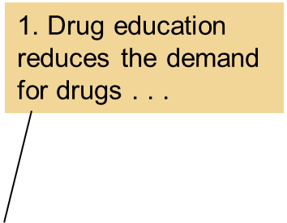
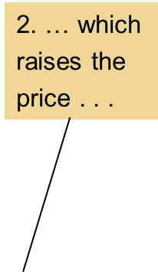
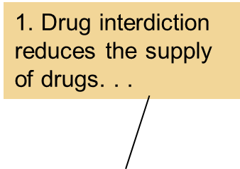
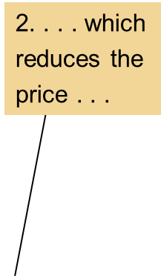
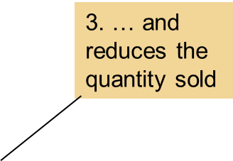
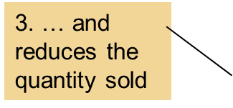
Figure 9
Policies to Reduce the Use of Illegal Drugs
(a) Drug Interdiction
(b) Drug Education
Price
Price
S₂
S₁
Supply
P₂
P₁
P₂
P₁
Demand
D₂
D₁
0
Q₂
Q₁
Quantity
0
Q₂
Q₁
Quantity
Drug interdiction reduces the supply of drugs from S₁ to S₂, as in panel (a). If the demand for drugs is inelastic, then the total amount paid by drug users rises, even as the amount of drug use falls. By contrast, drug education reduces the demand for drugs from D₁ to D₂, as in panel (b). Because both price and quantity fall, the amount paid by drug users falls
© 2015 Cengage Learning. All Rights Reserved. May not be copied, scanned, or duplicated, in whole or in part, except for use as permitted in a license distributed with a certain product or service or otherwise on a password-protected website for classroom use.

